Slide 1
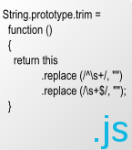

HTML Templates with Handlebars.js
Making JavaScript code by template!
Telerik Software Academy
Learning & Development Team
http://academy.telerik.com

Slide 2
Table of Contents
HTML Templates
Handlebars.js Template Engine
Setup and usage
Creating Templates
Binding values to HTML
Handlebars Expressions
Block and conditional
Helpers

Slide 3
HTML Templates
Overview

Slide 4
HTML Templates
HTML templates or template engines:
Make the HTML dynamic
Allow programming logic inside the otherwise static HTML
Provide cleaner and more sustainable way to dynamically create DOM elements
HTML templates are many:
Basic: Handlebars.js, mustache.js, underscore.js, jQuery templates
Advanced: KendoUI, AngularJS

Slide 5
Handlebars.js
Overview and Setup

Slide 6
Handlebars.js
Handlebars.js is an open-source template engine
Provides both run-time and compiled templates for rendering HTML
Allows one-way data-binding of HTML elements to JavaScript objects
Produces HTML code based on a template and a given JavaScript object

Slide 7
Setup and Usage
To use Handlebars follow the steps:
Download handlerbars.js
From the site at
Using bower and
Using NuGet
Src it in HTML file:
http://handlebarsjs.com/
$ bower install handlebars
search for "handlebars"
<script src="path/to/handlebars.js"></script>

Slide 8
Setup and Usage
(cont.) To use Handlebars follow the steps:
Create a template
In a script tag with invalid type attribute
<script id="post-template" type="text/x-handlebars-template">
<div class='post'>
<h1 class="post-title">{{title}}</h1>
<p class="post-content">{{{content}}}</p>
</div>
</script>
Render the template
var post = {title: '…', content: '…'},
htmlTemplate = postTemplateNode.innerHTML,
postTemplate = Handlebars.compile(htmlTemplate),
postNode.innerHTML = postTemplate(post);

Slide 9
Setup and Usage
Live Demo

Slide 10
Creating HTML Templates with Handlebars.js

Slide 11
Creating HTML Templates
HTML templates act much like string.Format() in C# and Java and stringWithFormat: @"…" in Objective-C
Put placeholders within a template string, and replace these placeholders with values
Handlebars.js marks placeholders with double curly brackets {{value}}
When rendered, the placeholders between the curly brackets are replaced with the corresponding value

Slide 12
Creating Templates: Example
Creating the template
<script id="post-template" type="text/x-handlebars-template">
<div class='post'>
<h1 class="post-title">{{title}}</h1>
<p class="post-content">{{content}}</p>
</div>
</script>
Create the JavaScript object and render the template to produce pure HTML code
var post = { title: 'Post Title', content: 'Post content' };
var postTemplateNode = document.getElementById('post-template'),
postTemplateHtml = templateNode.innerHTML,
postTemplate = Handlebars.compile(postTemplateHtml);
domNode.innerHTML = postTemplate(post);

Slide 13
Creating Templates
Live Demo

Slide 14
HTML Escaping
Handlebars.js escapes all values before rendering them
If the value should not be escaped there are two possibilities:
Use triple curly brackets in the template string
Mark in the value not to be escaped
Mostly used with helpers
{{{value}}}
var post = { title: '…',
content: new Handlebars.SafeString('…')
};

Slide 15
HTML Escaping
Live Demo

Slide 16
Handlebars Expressions
Blocks and Conditionals

Slide 17
Handlebars.js Expressions
Handlebars.js supports expressions within the templates
Block expressions
For iterating over a collection of elements
Conditional expressions

Slide 18
Block expressions
Block expressions are used to iterate over a collection of objects (like array)
Created using {{#collection}} and {{/collection}}
Everything between will be evaluated for each object in the collection
<ul class="categories-list">
{{#categories}}
<li class="category-item">
<a href="#/categories/{{id}}">{{name}}</a>
</li>
{{/categories}}
</ul>

Slide 19
Block expressions
Block expressions are used to iterate over a collection of objects (like array)
Created using {{#collection}} and {{/collection}}
Everything between will be evaluated for each object in the collection
<ul class="categories-list">
{{#categories}}
<li class="category-item">
<a href="#/categories/{{id}}">{{name}}</a>
</li>
{{/categories}}
</ul>
The id & name of every object

Slide 20
Block Expressions
Live Demo

Slide 21
Conditional Expressions
Render code only if a condition is fulfulled
Using {{#if condition}} {{/if}} or {{unless condition}} {{/unless}}
<h1>Posts</h1>
<ul class="posts">
{{#posts}}
<li>
<strong>
<a href="#/posts/{{id}}">{{title}}</a>
</strong>
{{#if author}}
<span class="author">by {{author}}</span>
{{/if}}
</li>
{{/posts}}
</ul>

Slide 22
Conditional Expressions
Render code only if a condition is fulfulled
Using {{#if condition}} {{/if}} or {{unless condition}} {{/unless}}
<h1>Posts</h1>
<ul class="posts">
{{#posts}}
<li>
<strong>
<a href="#/posts/{{id}}">{{title}}</a>
</strong>
{{#if author}}
<span class="author">by {{author}}</span>
{{/if}}
</li>
{{/posts}}
</ul>
If author is false-like value, this code will not be rendered

Slide 23
Conditional Expressions
Live Demo

Slide 24
Handlebars.js Helpers

Slide 25
Handlebars.js Helpers
Handlebars.js helpers are like functions that do predefined job
Build-in helpers:
{{#each collection}} {{/each}}
Much like block expressions but with more control like {{@index}} and {{this}}
{{#with obj}} {{/with}}
Used to minify the path
Write {{prop}} Instead of {{obj.prop}}

Slide 26
Using Built-in Handlebars.js Helpers
Live Demo

Slide 27
Registering Custom Helpers
Handlebars.js supports extension of the built-in helpers
Using Handlebars.registerHelper(…):
Handlebars.registerHelper ('tags', function(tags){
var html = '<ul class="tags-list">',
tag;
for(tag in tags){
html += '<li class="tag">' + tag + '</li>';
}
return new Handlebars.SafeString(html);
});

Slide 28
Registering Custom Helpers
Handlebars.js supports extension of the built-in helpers
Using Handlebars.registerHelper(…):
Handlebars.registerHelper ('tags', function(tags){
var html = '<ul class="tags-list">',
tag;
for(tag in tags){
html += '<li class="tag">' + tag + '</li>';
}
return new Handlebars.SafeString(html);
});
SageString is mandatory here

Slide 29
Registering Custom Helpers
Handlebars.js supports extension of the built-in helpers
Using Handlebars.registerHelper(…):
Handlebars.registerHelper ('tags', function(tags){
var html = '<ul class="tags-list">',
tag;
for(tag in tags){
html += '<li class="tag">' + tag + '</li>';
}
return new Handlebars.SafeString(html);
});
SageString is mandatory here
Otherwise the result will be escaped

Slide 30
Creating Handlebars.js Helpers
Live Demo

Slide 31
HTML Templates with Handlebars.js
http://academy.telerik.com

Slide 32
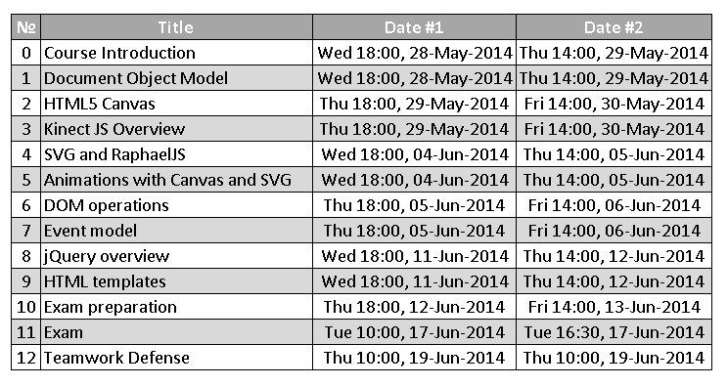
Homework
Create the following using Handlebars.js

Slide 33
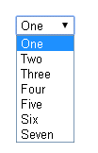
Homework (2)
Create a dynamic select using Handlebars.js
The options in the select should be generated based on a collection of JavaScript objects
Example:
var items = [{
value: 1,
text: 'One'
}, {
value: 2,
text: 'Two'
}];
var selectHTML = selectTemplate(items);

Slide 34

Homework (3)
*Create a jQuery plugin for ListView
Apply a template for each item of a collection
Using the data-template attribute set the ID of the template to use for the items
Must work with different collections and templates
*More examples on the next slides
<ul id="books-list" data-template="book-item-template"></ul>
<script id="book-item-template" type="…">
<li class="book-item">
<a href="/#books/{{id}}">
<strong>{{title}}</strong>
</a>
</li>
</script>
$('#books-list').listview(books);

Slide 35
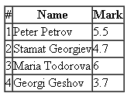
Homework (4)
*(cont.)Create a jQuery plugin for ListView
<table>
<thead>
<tr><th>#</th><th>Name</th><th>Mark</th></tr>
</thead>
<tbody id="students-table" data-template="students-row-template">
</tbody>
</table>
<script id="students-row-template" type="…">
<tr class="student-row">
<td>{{number}}</td>
<td>{{name}}</td>
<td>{{mark}}</td>
</tr>
</script>
$('#students-table').listview(students);

Slide 36
Homework (5)
*Extend the previous task to set the template inside the DOM element, instead of setting it with data-template
<table>
<thead>
<tr><th>#</th><th>Name</th><th>Mark</th></tr>
</thead>
<tbody id="students-table">
<tr class="student-row">
<td>{{number}}</td>
<td>{{name}}</td>
<td>{{mark}}</td>
</tr>
</tbody>
</table>
$('#students-table').listview(students);

Slide 37




Free Trainings @ Telerik Academy
“C# Programming @ Telerik Academy
csharpfundamentals.telerik.com
Telerik Software Academy
academy.telerik.com
Telerik Academy @ Facebook
facebook.com/TelerikAcademy
Telerik Software Academy Forums
forums.academy.telerik.com

